Slide 1
Open Innovation Challenge – IV Live Fitness Feed, Diet and Fitness Assistant for Corporate Employees Ismail Mohammed, Rijo Abraham, Abhay Paropkari, Bishik Pal, Nihad Ahmed, Gurjeet Singh, Purushotham Singh, Mannava Phalani
This slide does not contain any export regulated technical data

Slide 2
Contents
Problem or challenge identified
Technology solution proposed (POC Implementation)
Solution architecture
Investment and Time-line
Help Needed
Profile of Team Members

Slide 3
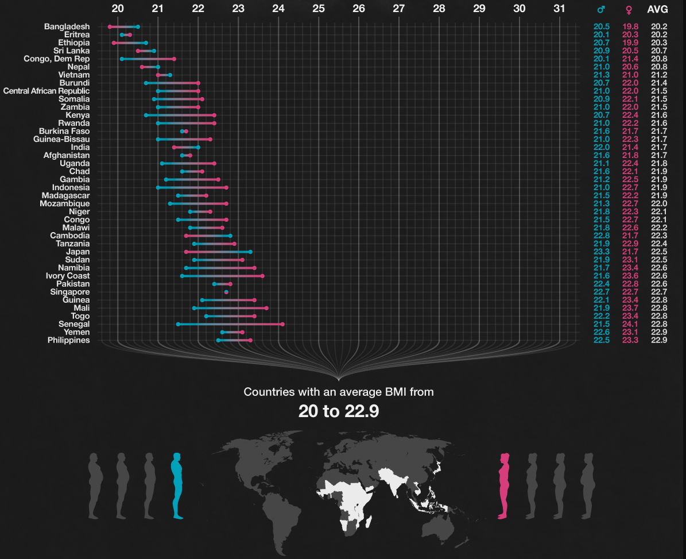
Problem or challenge identified
The Problem: Obesity and Unhealthy Standards
Obesity in India has stretched to rampant proportions in the 21st century.
Morbid obesity is affecting 5% of the country's population.
Unhealthy, processed food is now highly accessible following India's continued integration in global food markets.
The Indian Council of Medical Research has released guidelines that state that a BMI of over 23 kg/m² is considered overweight (As compared to the international standards of 25 kg/m²)
On an average, about 12% of the Males in India and 16% of the females in India respectively are considered overweight.

Slide 4
Technology solution proposed
Proposed Solution:
Fitness feed, Diet and Workout assistant.
Monitor daily fitness levels.
Recommend a personalized diet for individuals.
Compute the Fitness levels of an individual with respect to the Body Mass Index (BMI), which would be the basis of recommending the diets and workout plans. These would also take into account the calorie intake and the subsequent calories burnt by an individual.
Propose fitness regimes to improve the BMI of an individual to an optimum level.
A live fitness assistant would in turn prove to be a healthy reminder to keep a check on one’s eating habits as well as their fitness routines on a daily basis.
This would, eventually, lead to a stress free and healthy environment which is relatively hard to see in a corporate culture.

Slide 5
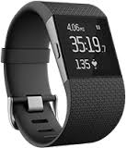
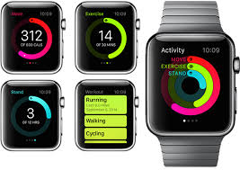
Solution - Comparison to Benchmarks
The proposed solution that we have in mind can be compared to “Fitbit” and the “Apple Watch”; the wearable fitness assistants that we have in the market.
There are many pros and cons when we compare our proposed solution to the one available as of now.
The Fitbit and the Apple Watch focus more towards the fitness regimes of an individual while giving those results quite accurately while not providing diet suggestions or tips.
Our solution, on the other hand, focuses more towards adopting a balanced diet while also maintaining a good fitness regime at the same time.
The accuracy with respect to the intake of calories and the calories burnt through exercise may be inaccurate. However, our balanced diet tips, fitness regimes and interactive charts are quite substantial along with the relatively lower costs of implementation.

Slide 6
Technology solution proposed
POC Implementation Plan:
The POC for our proposed solution will be executed in the IHI block with a sample size of 40 individuals.
Data Collection:
The Inputs required to calculate the BMI of an individual are height and weight.
The weight of the individual is to be collected using pressure/load sensor strips (through Raspberry pi) that are attached to the tile/mat located in front of the RF ID card swipe reader of the CoE..
For testing purposes, each individual in the testing sample would be provided a unique barcode that will be attached to their respective IDs.
A camera (Logitech HD Camera) in tune with the Raspberry pi, would then be used to read an individual’s ID data (ID number) using this unique barcode. Every individual’s weight is then collected and stored against a specific ID when they swipe their cards to enter the blocks.
This data is then sent to the server (Google Drive), where we would store the data using a local hotspot/Dongle/Wi-Fi router for further analysis.
The height, however, is retrieved from the company’s associate database for the respective Employee ID (From HR Online or Manually Collected Data).

Slide 7
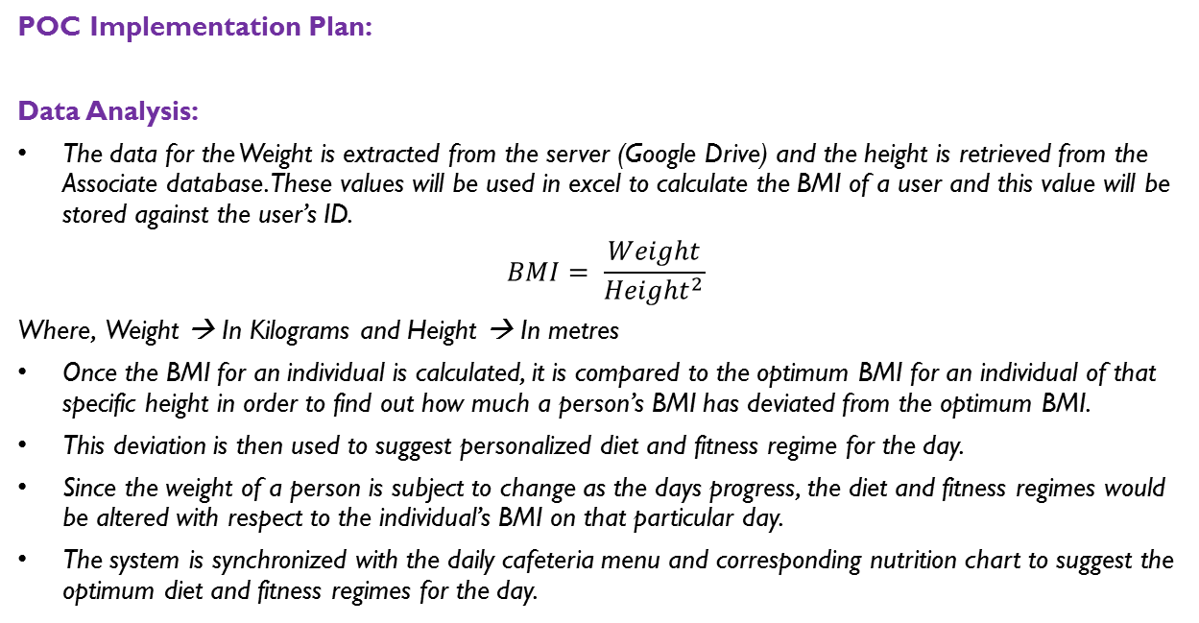
Technology solution proposed
POC Implementation Plan:
Data Analysis:
The data for the Weight is extracted from the server (Google Drive) and the height is retrieved from the Associate database. These values will be used in excel to calculate the BMI of a user and this value will be stored against the user’s ID.
$$BMI= \frac{Weight}{{Height}^{2}}$$
Where, Weight → In Kilograms and Height → In metres
Once the BMI for an individual is calculated, it is compared to the optimum BMI for an individual of that specific height in order to find out how much a person’s BMI has deviated from the optimum BMI.
This deviation is then used to suggest personalized diet and fitness regime for the day.
Since the weight of a person is subject to change as the days progress, the diet and fitness regimes would be altered with respect to the individual’s BMI on that particular day.
The system is synchronized with the daily cafeteria menu and corresponding nutrition chart to suggest the optimum diet and fitness regimes for the day.

Slide 8
Technology solution proposed
POC Implementation Plan:
Action:
Send a system generated notification mail to individuals recommending the optimum diet and fitness regime for the day using the script in a VBA macro.
Send an action SMS detailing the optimum diet and fitness regime for the day as well.
Display vital statistics like the Average CoE fitness levels and Percentage deviation from the optimum BMI on the local LCD monitor (for the CoE). Provide data such as target BMIs. Also allow a user to track his/her fitness levels on a daily basis.
A Schematic representation of this proposed plan is presented in the next slide.

Slide 9


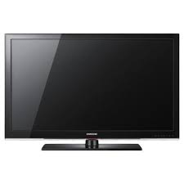

Technology solution proposed
A schematic representation (Summary) of the POC Implementation Plan:
Data Collection: (Pressure Strips, RF Reader, Camera, Raspberry Pi) Wi-Fi Router/Hotspot Server
Data Analysis: Server Data Processing (Excel) Server (Output)
Action: Server (Output) Wi-Fi Router/Hotspot Mail/SMS/LCD Display
Data Processing
Cyient
Mails
LCD Display
Server
Entrance
ID card
RF Reader
Camera
Pressure/Load strips

Slide 10
Solution architecture (Hardware and Software)
Sensors and Data collection:
Pressure Sensors
Raspberry pi
Communication and data storage:
Wi-fi Modem
Google Drive or Box (for POC)
Data analysis:
MS Excel (for POC)
Action
Mail / SMS
LCD display.

Slide 11
Help Needed – Hardware, Software, Technology
Hardware:
Raspberry pi
Mat/Tile
Hardware permissions for experimental set-up in IHI block
Internet Connectivity
Wi-Fi router
Software:
Python
Access to Respective heights of the testing sample of employees

Slide 12
Investment and Time-line
Investment
Timeline

Slide 13
Summary
We live and work in a stressful environment which directly or indirectly has an adverse effect on the mental and physical health of a person. This leads a person to ignore their health and lead a relatively unhealthy life due to unrestrained eating habits and unchecked stress.
This leads to obesity and an unhealthy lifestyle, which can be avoided if certain steps are followed.
The solution we propose provides a way for an individual to keep a check on their fitness and monitor their diet as the days go by.
Our technological idea provides an individual with a daily diet, synchronized fitness regimes and a constantly updated BMI for an individual to evaluate their fitness levels while suggesting multiple ways to get their BMI into the optimum range.
In this process, one can maintain a fit, stress-free and healthy lifestyle.

Slide 14
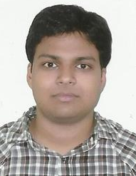
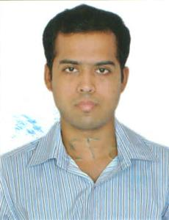
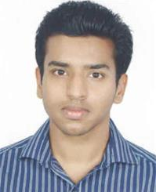
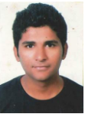

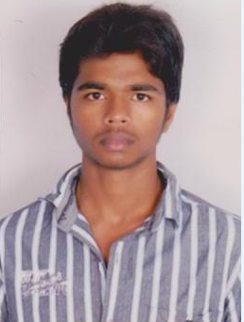
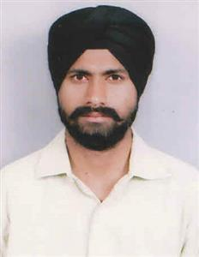
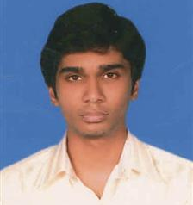
Team members profile
Bishik Pal
A&D-UTC-SOFT-ELECT-APP SW-UTAS India
Manikonda Tower-1,GC
Hyderabad, India
Nihad Ahmed
A&D-UTC-SOFT-ELECT-APP SW-UTAS India
Manikonda Tower-1,GC
Hyderabad, India
Rijo Abraham
A&D-UTC-DESIGN & DRAFTING-EMERGING ACCOUNTS
CentralTower-3A
Hyderabad, India
Mannava Phalani
TRANSPORT-RAIL-RAIL ROLLING STOCK_BT-BT_WMA_India
Hyderabad, India
Abhay Paropkari
A&D-UTC-DESIGN & DRAFTING-EMERGING ACCOUNTS
Central Tower - 3A
Hyderabad, India
Purushotham Singh
A&D-UTC-SYSTEMS & ANALYSIS-PSA-PWA India
Central Tower-1,3C
Hyderabad, India
Gurjeet Singh
A&D-UTC-DESIGN & DRAFTING-EMERGING ACCOUNTS
Manikonda Tower-1,3A
Hyderabad, India
Ismail Mohammed
A&D-UTC-DESIGN & DRAFTING-EMERGING ACCOUNTS
Central Tower-3A
Hyderabad, India

